Slide 1
Microprocessor System Design
Omid Fatemi
(omid@fatemi.net)

Slide 2
Class Work #8
Timer - AVR

Slide 3
Closed Book

Slide 4
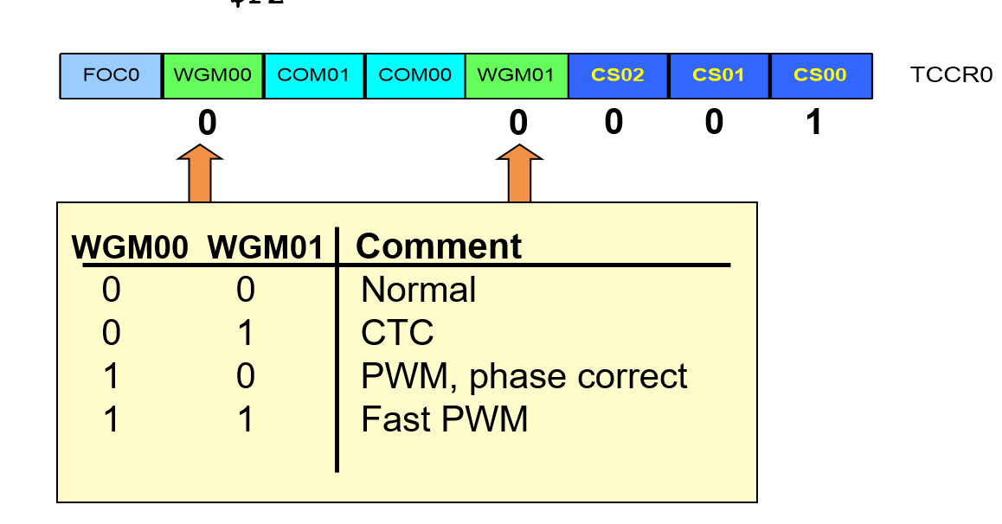
Questions
What is TCNTn (Timer/Counter register)?
How could you use OCFn (Output Comapre flag) in your program?
What is the role of prescaler in assigning the clock source of the counter?
How Timer/Counter 0 is configured as a timer and how as a counter?
What are CTC mode and OCR0?
Notes:
Describe the size of existing timers in ATmega32?
What are the possible clock sources for Timer/Counter 0?
How could you use TOVn (Timer overflow flag) in your program?
Explain normal mode
Explain CTC mode

Slide 5
Open-Note
Describe the size of existing timers in ATmega32?
What are the possible clock sources for Timer/Counter 0?
How could you use TOVn (Timer overflow flag) in your program?
Explain normal mode
Explain CTC mode

Slide 6
Problems
The problem is to build a frequency-meter using an AVR. To measure the cycle time (period) of a signal, the number of 1 micro second pulses are counted in one cycle of the signal. The range of input signal (connected to PA.0) is between 4KHz to 30 KHz. The start button is connected to PA.1. The micro is connected to 8MHz clock.
Design the circuit. Explain the operation.
Program PA and the timer 0 of AVR (clk / 8, normal mode)
Write the subroutine start_timer which starts the timer 0 from 0.
Write the subroutine stop_timer which stops the timer 0.
Write the main program. The start button is scanned and when it is pressed, the input signal is polled. With a rising edge, call start_timer and with the next rising edge stop_timer. Store the counted number in memory location 0x60. This number represents the period in micro seconds. Then, it waits for a button again.
What would be the maximum possible number for the period? Why?
How accurate is this frequency meter? (don’t write 1 micro second, look at the instructions and discuss)
Could we use timer0 in CTC mode? Discuss.

